Slide 1



JASPER JONES
Bildungsroman

Slide 2
Lesson Aims and Objectives:
To explore anti-ethical texts
Investigate the themes each text raises and the relevance to contemporary society
Develop ways of taking the texts into the classroom to stimulate analysis of texts.

Slide 3
Definitions:
Anti-ethical: directly opposed or contrasted; mutually incompatible
Redemption: the action of saving or being saved from sin, error, or evil.
Butterfly Effect: the phenomenon whereby a minute localized change in a complex system can have large effects elsewhere.

Slide 4
HISTORICAL CONTEXT
Post-Colonialisation
Colonialisation
Aboriginal Act
Immigration Act 1901 (White Australia Policy)
Kevin Rudd’s Sorry Speech (2008)
1967 Referendum
The Vietnam War – Australia’s involvement
Eric Edgar Cooke – crimes and upbringing; impact on Perth ‘the big country town’
Factors that influenced rural and city factors in the 1960’s

Slide 5
Themes
Morality and Ethics
Responsibility and Culpability
Atonement
Law and Legality
Race and Ethnicity
Racism
Others
Xenophobia
Hegemonic systems
Resource/currency

Slide 6
THEORISTS
Maslow
Trolley
Kant
Plaito
Voltaire
Nitche
Machiavelli
Chaos Theory: Butterfly effect - the analogy of a butterfly flapping its wings in South America causing a hurricane half a world away by creating a tiny disturbance to air currents. Discuss how this idea of seemingly small events having large ramifications plays out in the novel.
Edward Said
Bhabha
Spivak

Slide 7
SETTING
What effect does the setting have on the characters?
How do the characters interact with their environment? How does their outlook/attitude change? What is gained? What is lost?
Natural/Manufactured/Cultural/Political
Australian Culture - Small, Fictional Mining Town in Corrigan in Relational Western Australia, 1965.

Slide 8
Relationships
Anti-ethical - scapegoats
the chaos theory
our relationships juxtaposed with, and placed onto, new landscapes
- what has changed?
- what boundaries have been blurred/crossed?

Slide 9
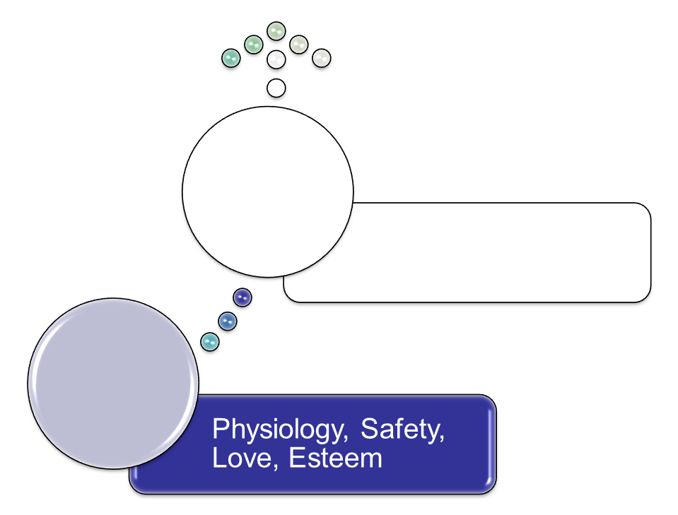
ABRAHAM MASLOW’S
HIERARCHY OF NEEDS
Only 1 in 100 reaches self-actualization
Growth
Basic

Slide 10
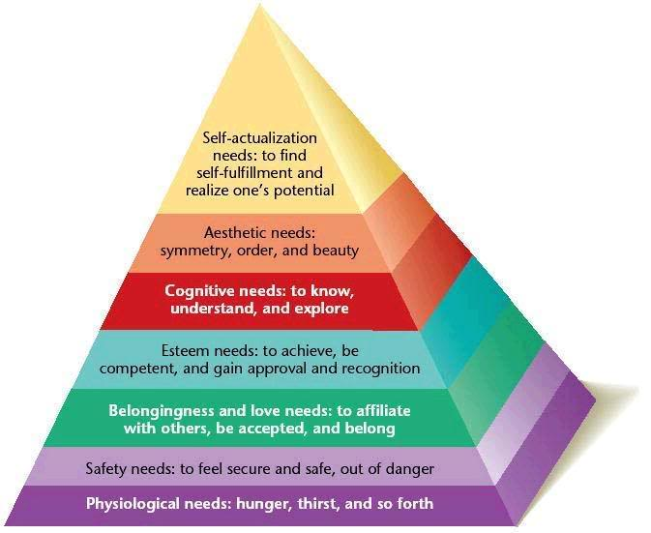
NEEDS PYRAMID
Not original to Maslow

Slide 11

APPLICATION FOR
JASPER JONES
Consider the characters. Provide examples of how each character functions at least 3 levels. In what level do you think each character functions the most? Explain your reasoning. How does your analysis confound Maslow’s theory?

Slide 12
STYLE
Author; voice (characters)
Repetition: Characters consistently using the word ‘sorry’

Slide 13
CHARACTERS
Protagonist: …..– why? Write ten dot points of why – Give me a good quote here
Contagonist
Flat:,
Stock:
Round:
Antagonist

Slide 14
POV

Slide 15
VALUES AND ATTITUDES

Slide 16
SYMBOLISM

Slide 17
SYMBOLISM

Slide 18
READING THEORY
Gaps and silences
Foreground and privileging
Passive and segregated
Dominant
Resistant
Alternate

Slide 19
CLT

Slide 20
INTERTEXTUALITY
Herbie
Rhinocerus Beetle
Kevin Rudd’s Apology to the Stolen Generations: Structured Controversy: does saying sorry means accepting blame and admitting guilt?
To Kill a Mockingbird – Atticus Finch (Harper Lee)
Catcher is the Rye – Holden Caulfield (J.D. Salinger)
Huckleberry Finn & Tom Sawyer – Huckleberry Finn (Mark Twain)

Slide 21
QUESTIONS
How is Australian culture represented in the novel?
What are the attitudes towards Aboriginal people and immigrants?
What is valued more in the town – intellect or sporting prowess?
What does Charlie value in life?
What do you believe the author’s purpose was in writing the novel?
Novels, whilst set in a different context, can teach us lessons that are relevant in today’s society. Discuss with reference to Jasper Jones.
Racial Prejudice, Ignorance and Injustice are key themes that appear in Jasper Jones. How do characters convey these to the reader?

Slide 22
LANGUAGE
Admonitory
Utalitarianism
Totalitarianism
Consumerism
Psychosis
Capitalism
Humanocentricism
Eschatology
Anachronism
Collectivism
Priori
Absolutism
Posteriori
Dehumanisation
In-media-res
Darwinism
Millenialism

